Slide 1
Marko Krasnyk
vice president of charity foundation “Dzvin”
Lviv, Ukraine

Slide 2
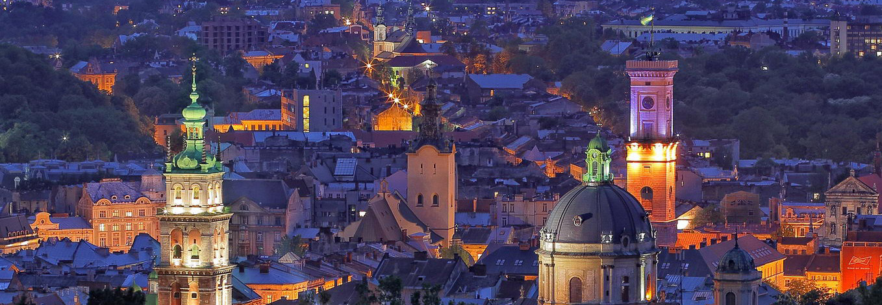
Who we are?
We are charity foundation from Western Ukraine (Lviv), which is the first foundation for CF patients in Ukraine.

Slide 3
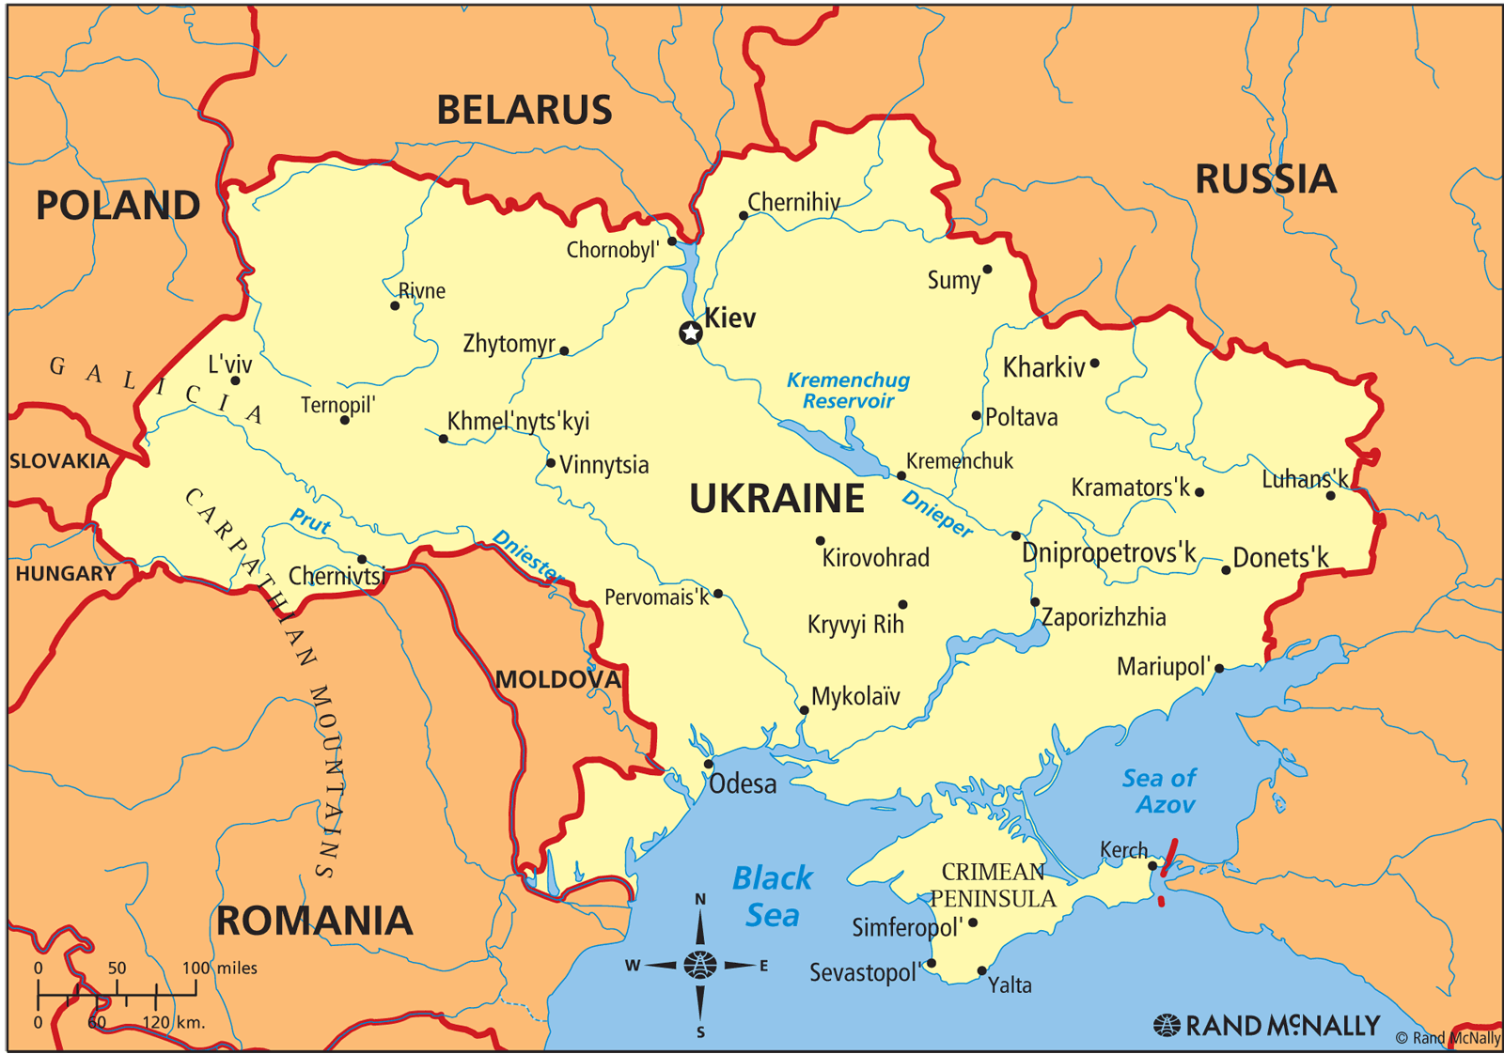
General statistics
Ukraine
Population: 46 000 000
Number of CF patients (diagnosed) ~1 000
CF children ~800 - 900
CF adults ~60 - 100
Number of CFTR related disorders pts. unknown

Slide 4
Center for adult CF patients
Our association in cooperation with Lviv Regional Center of medical care for children with CF & Ukraine Genetic Pathology Institute has achieved the first in Ukraine Center for adult patients.
Center for adult CF patients will begin its work from the fall of this year.
The only and the first in Ukraine Center for adult CF patients is created at Lviv Regional Hospital for war veterans and repressed.
Medical staff will receive qualified training for CF patient’s management.
Our pulmonologist, who will treat adult CF patients, was trained in Lviv Regional Center of medical care for children with CF.
The government has already allocated the necessary funds for medicines for adult CF patients.

Slide 5
Medicines
CF children in Lviv and Lviv region receive Creon, Dornase alfa, Ursofalk (Ursolisin) for free.
In 2018 adult CF patients will start to receive these free medicines too.
CF “DZVIN", together with the Center of treatment of children with CF this year initiated a psychological surveys measurements mental well-being of children with CF. We hope in support of CF-Ukraine to cover as many patients

Slide 6
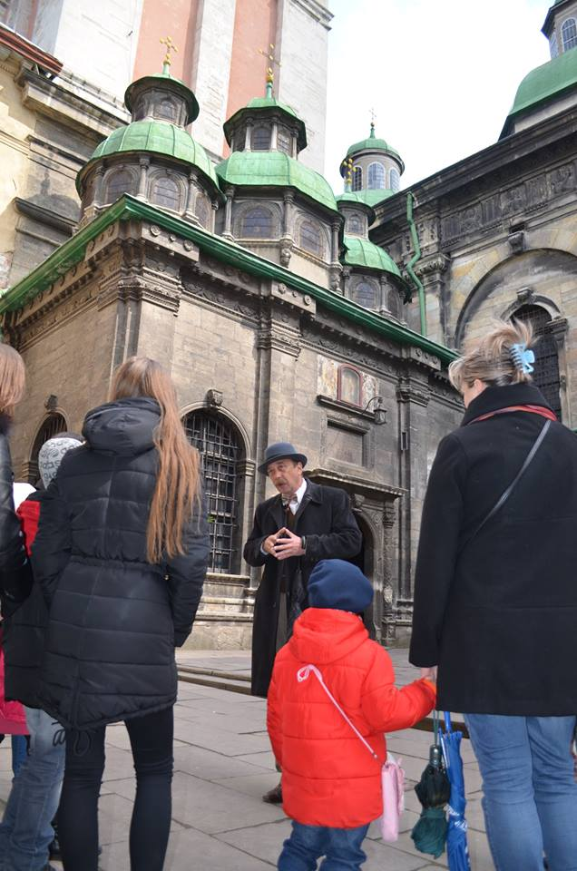
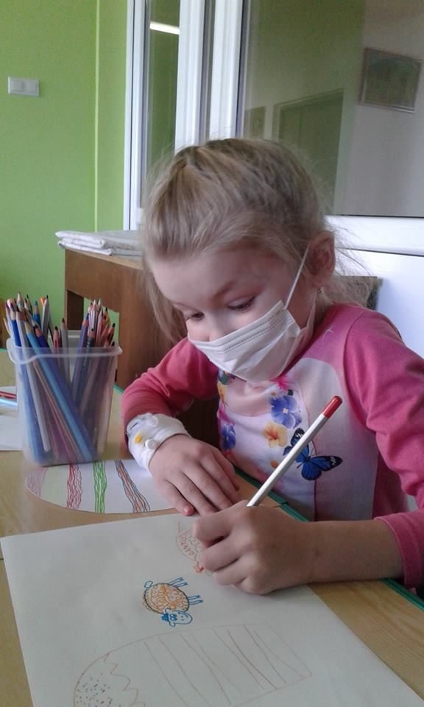
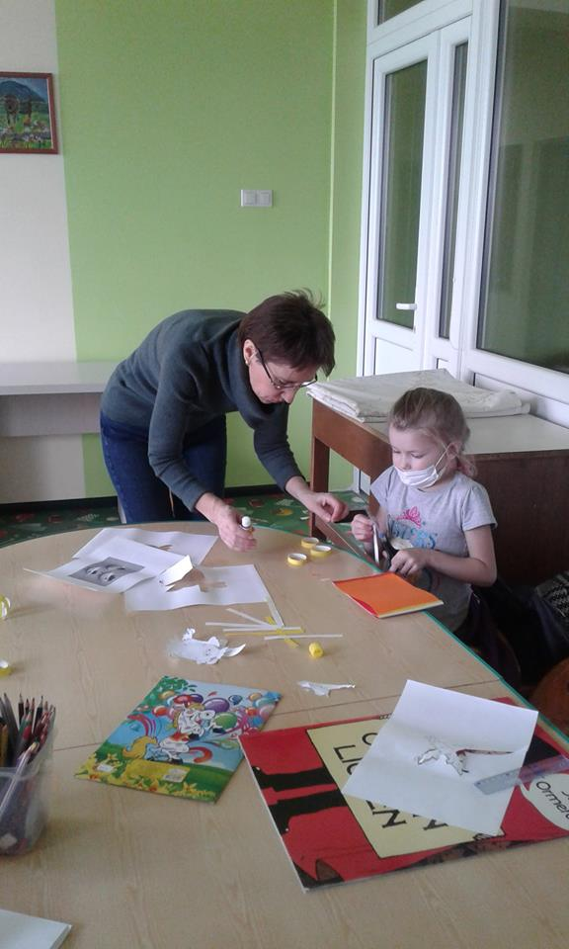
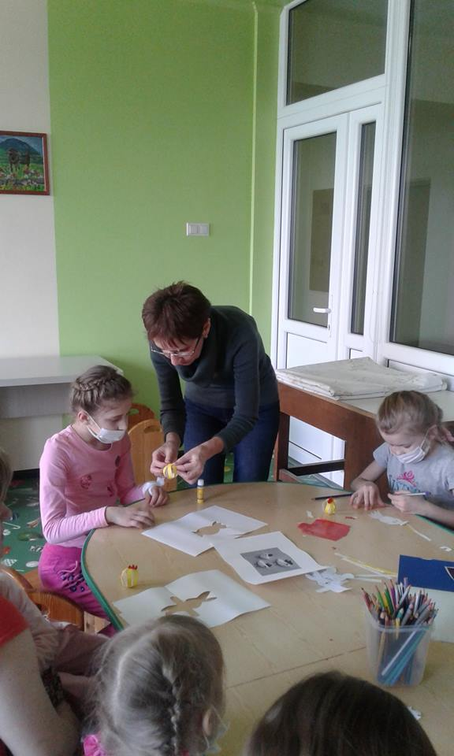
Social part
This year we signed a contract with the Lviv City Hall about the constant free guided tours of Western Ukraine for CF children and adults.
For children with undergoing treatment in hospital every Monday are organized master classes of needlework (handmade toys, jewelry), painting, dancing, singing, that are taught by professional musicians and artists.
We try to make our children feel happy☺

Slide 7
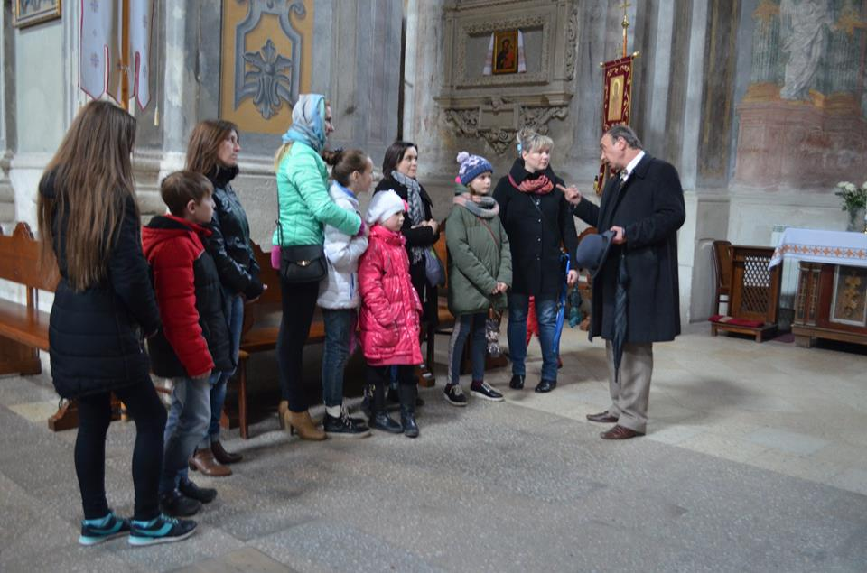
Social part
This year we signed a contract with the Lviv City Hall about the constant free guided tours of Western Ukraine for CF children and adults.
For children with undergoing treatment in hospital every Monday are organized master classes of needlework (handmade toys, jewelry), painting, dancing, singing, that are taught by professional musicians and artists.
We try to make our children feel happy☺

Slide 8
Thanks for your attention!
www.cfu.com.ua
info@cfu.com.ua

